Slide 1
Physical Layer: Multiplexing, Spectrum Spreading & Switching
Covers Chapters# 06 & 08 from Text Book
Computer Communication & Networks
(CEN-223)
Fall 2022 (BSE-5A)

Slide 2
Multiplexing
From Chapter#06

Slide 3
Multiplexing
If bandwidth of a medium linking devices is greater than the bandwidth needed by the devices, then link can be shared simultaneously.
Multiplexing: set of techniques that allow simultaneous transmission of multiple signals across a single link, hence achieving bandwidth efficiency.
Link → physical path; Channel → the portion of link that carries a transmission between a given pair of lines.
One link can have many channels.

Slide 4
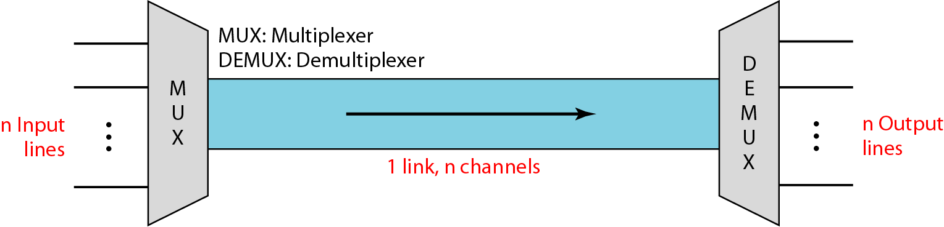
Multiplexing (Cont.)
Dividing a link into channels

Slide 5
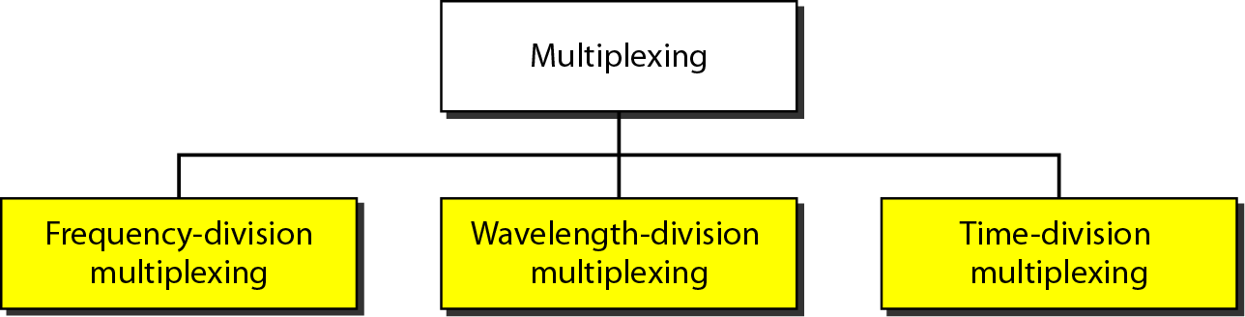
Multiplexing (Cont.)
Three basic multiplexing techniques:
Frequency-division multiplexing (FDM)
Time-division multiplexing (TDM)
Wavelength-division multiplexing (WDM)

Slide 6
Frequency-Division Multiplexing
FDM: a multiplexing technique that divides the spectrum into frequency channels, with each user having exclusive possession of channel(s).
FDM can be applied when bandwidth of a link is greater than the combined bandwidths of signals to be transmitted.
Channels are separated by strips of unused bandwidth, known as guard bands, which helps in preventing signals overlap.

Slide 7
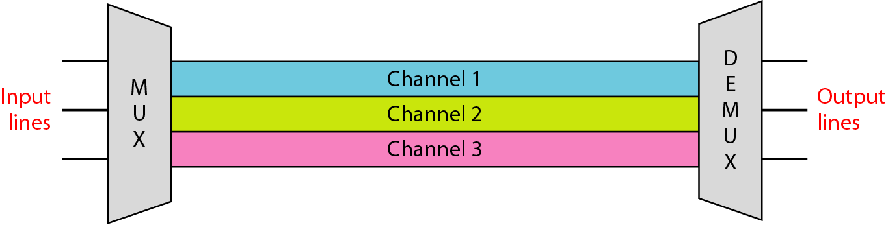
Frequency-Division Multiplexing (Cont.)
Frequency-division multiplexing

Slide 8
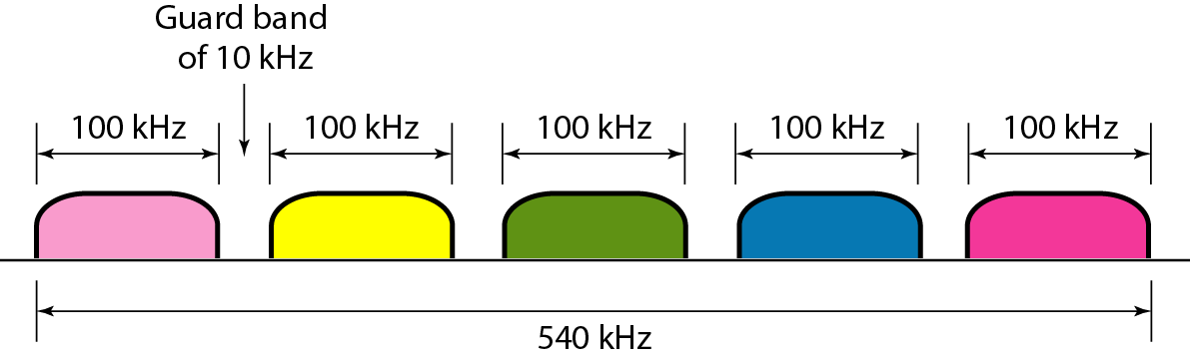
Frequency-Division Multiplexing (Cont.)
Example: Five channels, each with a 100-kHz bandwidth, are to be multiplexed together using FDM. What is the minimum required bandwidth of the link if there is a need for a guard band of 10 kHz between the channels to prevent interference?
Solution: For five channels, we need at least four guard bands. This means that the minimum required bandwidth is (5 × 100) + (4 × 10) = 540 kHz.

Slide 9
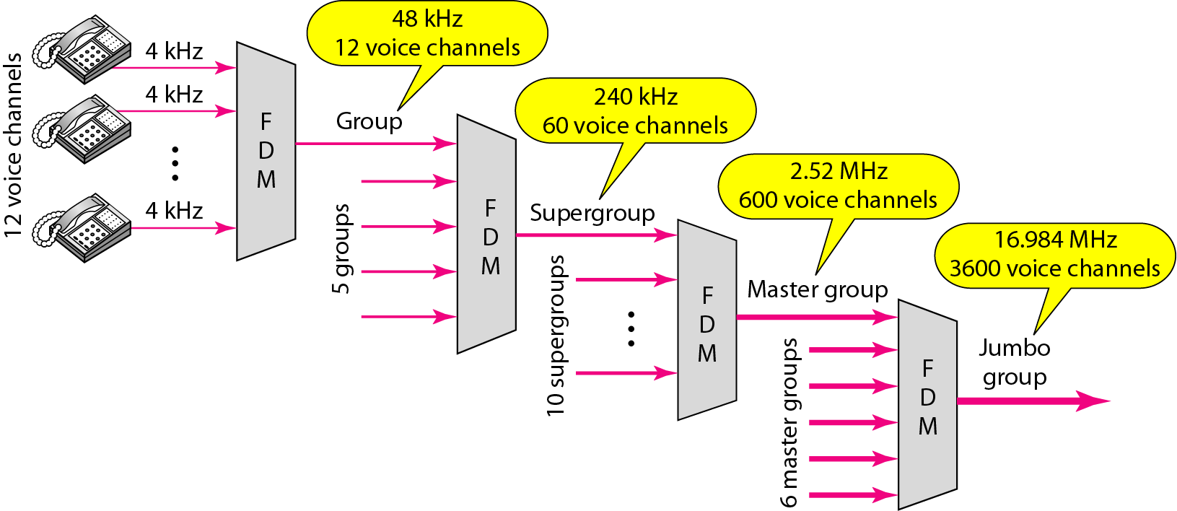
Frequency-Division Multiplexing (Cont.)
Example of FDM hierarchical system used by telephone companies.
Note: guard bands are inserted into master group and jumbo group, hence increasing required bandwidth.

Slide 10
Frequency-Division Multiplexing (Cont.)
FDM applications;
AM and FM radio broadcasts.
TV channels broadcast.
1st generation of cellular systems (AMPS).

Slide 11
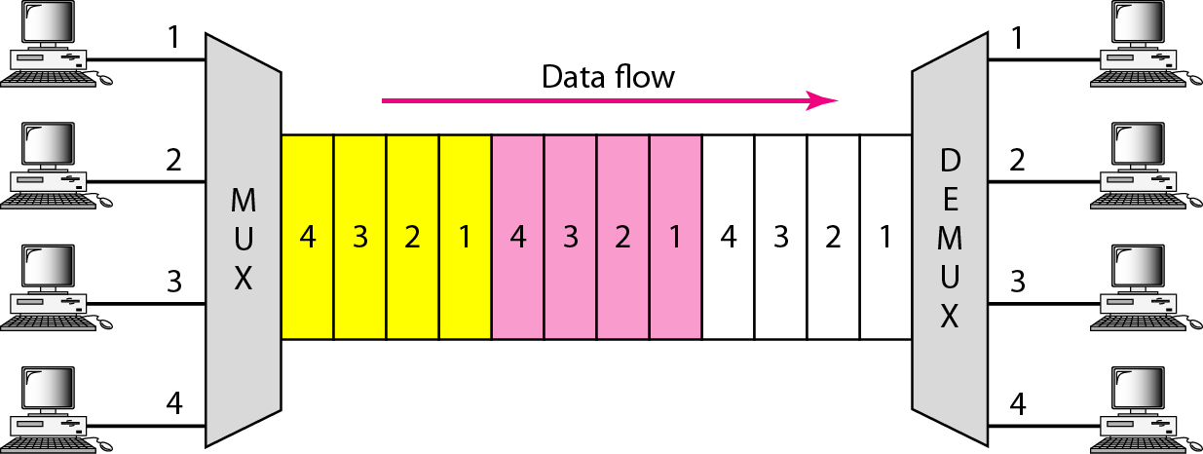
Time-Division Multiplexing
TDM: a multiplexing technique that allows to combine several low-rate channels into one high-rate channel.
In TDM, the entire bandwidth is shared in terms of time, i.e. each connection occupies a portion of time in the link.
TDM applications: GSM cellular networks.

Slide 12
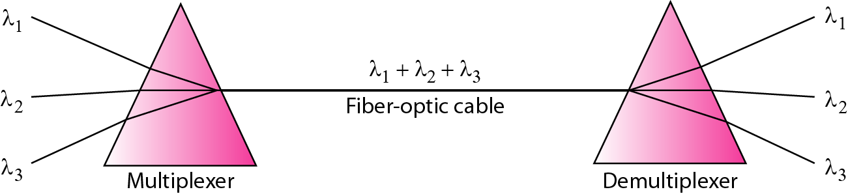
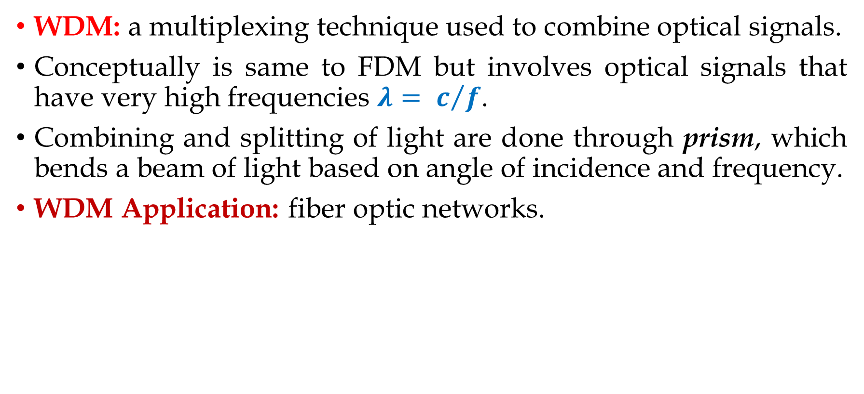
Wavelength-Division Multiplexing
WDM: a multiplexing technique used to combine optical signals.
Conceptually is same to FDM but involves optical signals that have very high frequencies $λ= c/f$.
Combining and splitting of light are done through prism, which bends a beam of light based on angle of incidence and frequency.
WDM Application: fiber optic networks.

Slide 13
Spread Spectrum
From Chapter#06

Slide 14
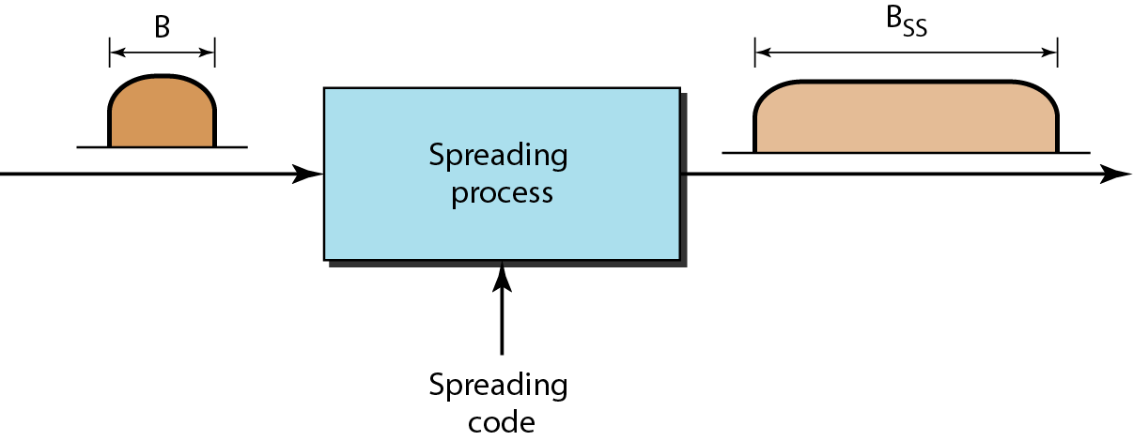
Spread Spectrum
Spread spectrum: spreading the original frequency spectrum B into a larger spectrum B_{ss}, where B_{ss} >> B.
Designed to be used in wireless applications for devices to share the medium without being intercepted by eavesdropper or being jammed by intruders.

Slide 15
Spread Spectrum (Cont.)
Two techniques to spread the bandwidth:
Frequency hopping spread spectrum (FHSS).
Direct sequence spread spectrum (DSSS).

Slide 16
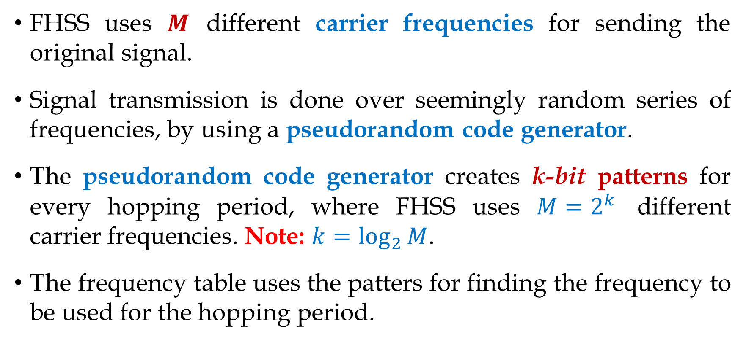
FHSS
FHSS uses $M$ different carrier frequencies for sending the original signal.
Signal transmission is done over seemingly random series of frequencies, by using a pseudorandom code generator.
The pseudorandom code generator creates k-bit patterns for every hopping period, where FHSS uses $M=2^{k}$ different carrier frequencies. Note: $k=\log_{2}{M}$.
The frequency table uses the patters for finding the frequency to be used for the hopping period.

Slide 17
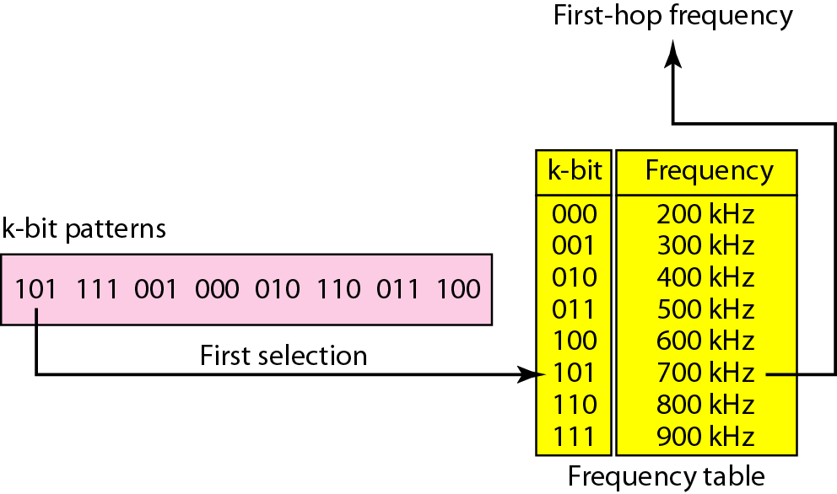
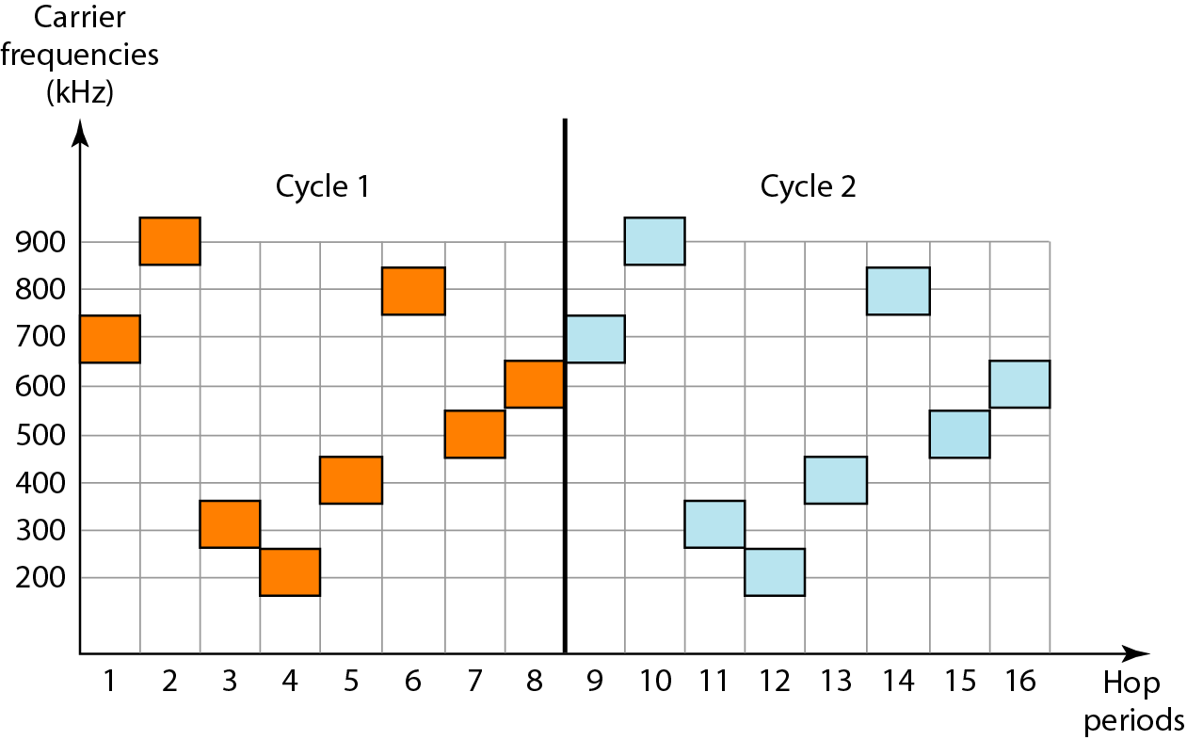
FHSS (Cont.)

Slide 18
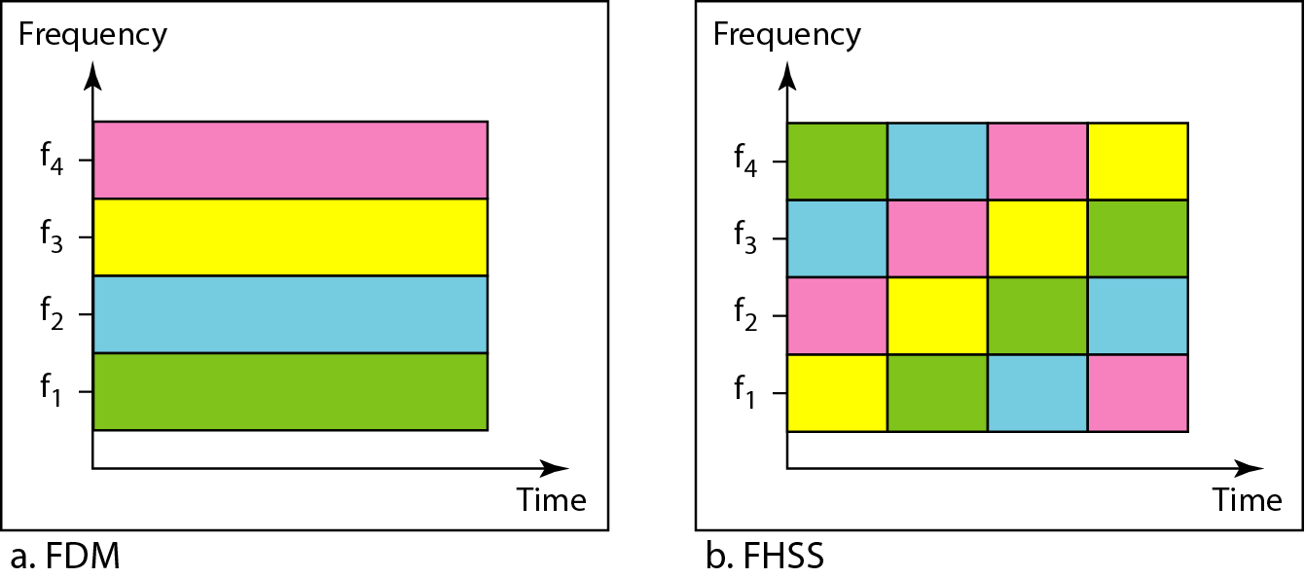
FHSS (Cont.)

Slide 19
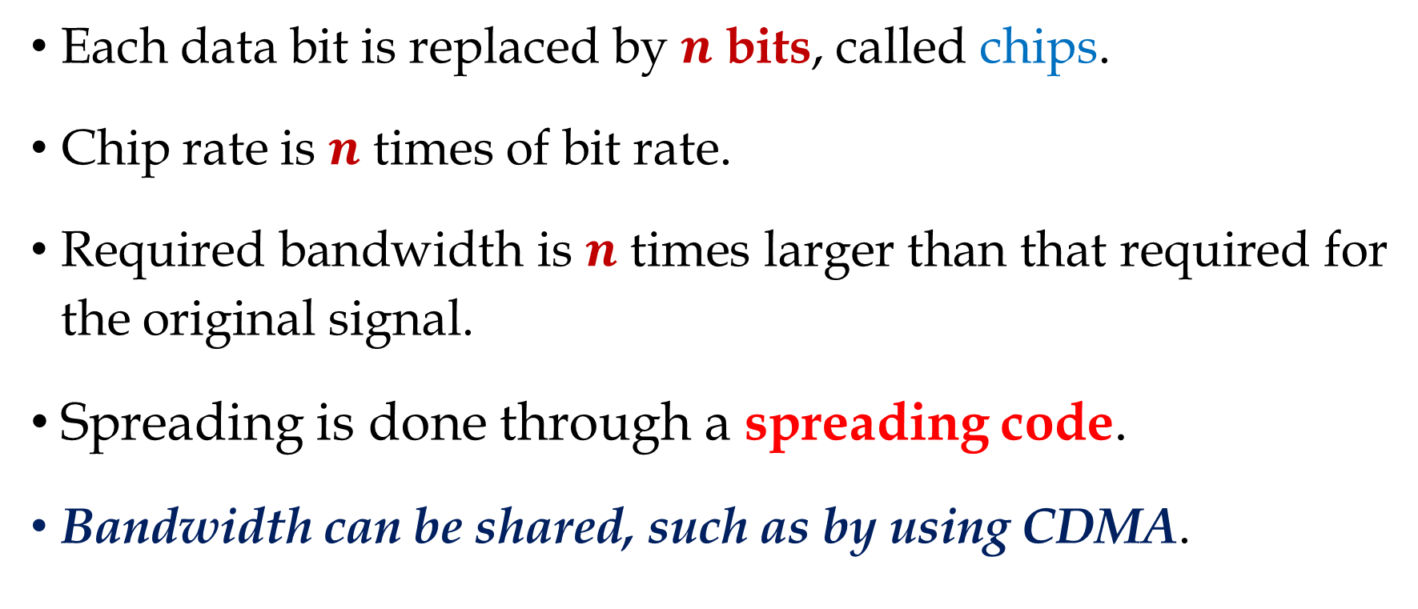
DSSS
Each data bit is replaced by $n$ bits, called chips.
Chip rate is $n$ times of bit rate.
Required bandwidth is $n$ times larger than that required for the original signal.
Spreading is done through a spreading code.
Bandwidth can be shared, such as by using CDMA.

Slide 20
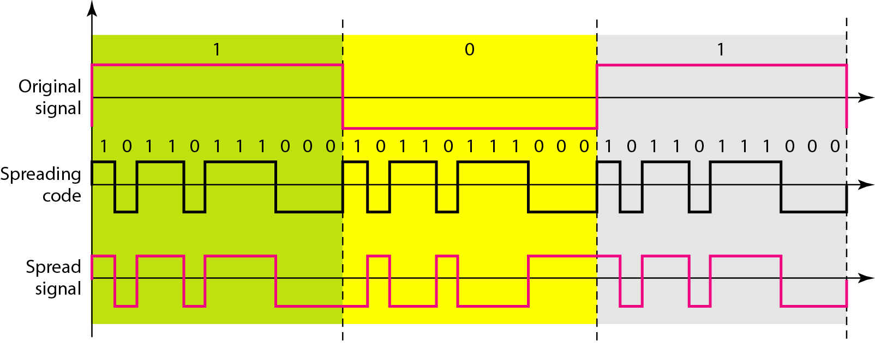
DSSS (Cont.)

Slide 21
Switching
From Chapter#08

Slide 22
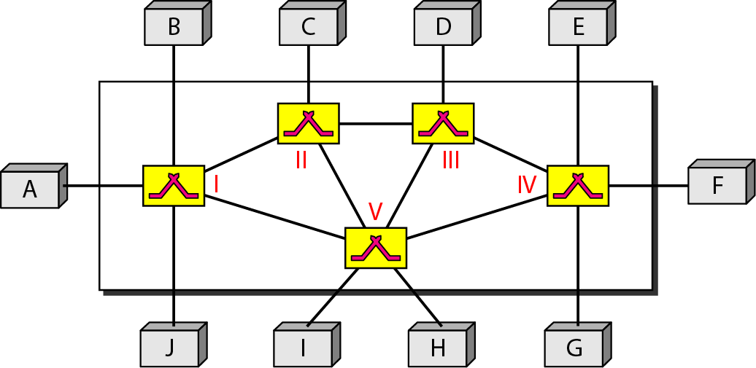
Switched Networks
Switched network: a network that consists of a series of inter-linked nodes, called switches, suitable for very large networks.
Switch: a device capable of creating temporary connections between two or more devices linked to the switch.
Methods of Switching:
Circuit switching
Packet switching
Datagram approach
Virtual circuit approach
Message switching

Slide 23
Switching in TCP/IP Network Model
Switching can happen at several layers of TCP/IP protocol suite:
Switching at physical layer, we have only circuit switching.
Switching at data-link layer, we have packet switching and is performed using the virtual-circuit approach.
Switching at network layer, we have packet switching and is performed using the datagram approach.
Switching at application layer, we have message switching.

Slide 24
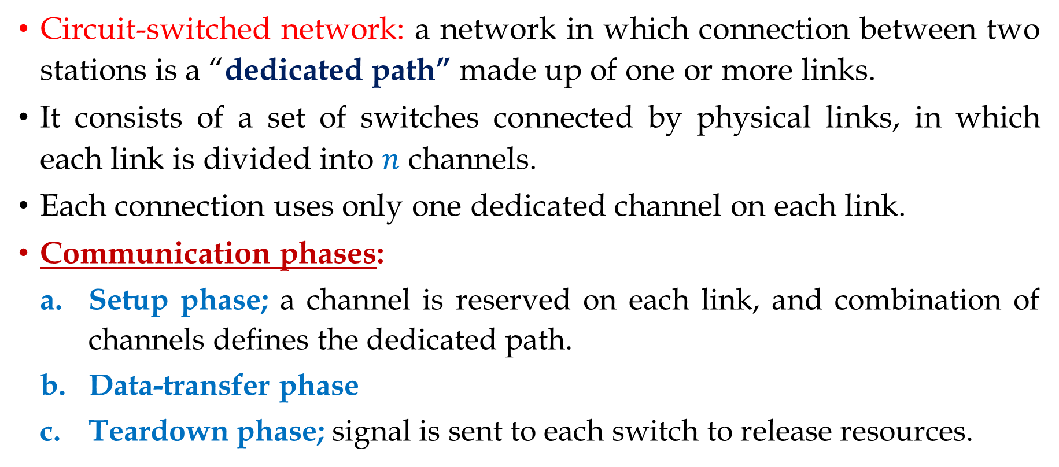
Circuit-Switched Networks
Circuit-switched network: a network in which connection between two stations is a “dedicated path” made up of one or more links.
It consists of a set of switches connected by physical links, in which each link is divided into $n$ channels.
Each connection uses only one dedicated channel on each link.
Communication phases:
Setup phase; a channel is reserved on each link, and combination of channels defines the dedicated path.
Data-transfer phase
Teardown phase; signal is sent to each switch to release resources.

Slide 25
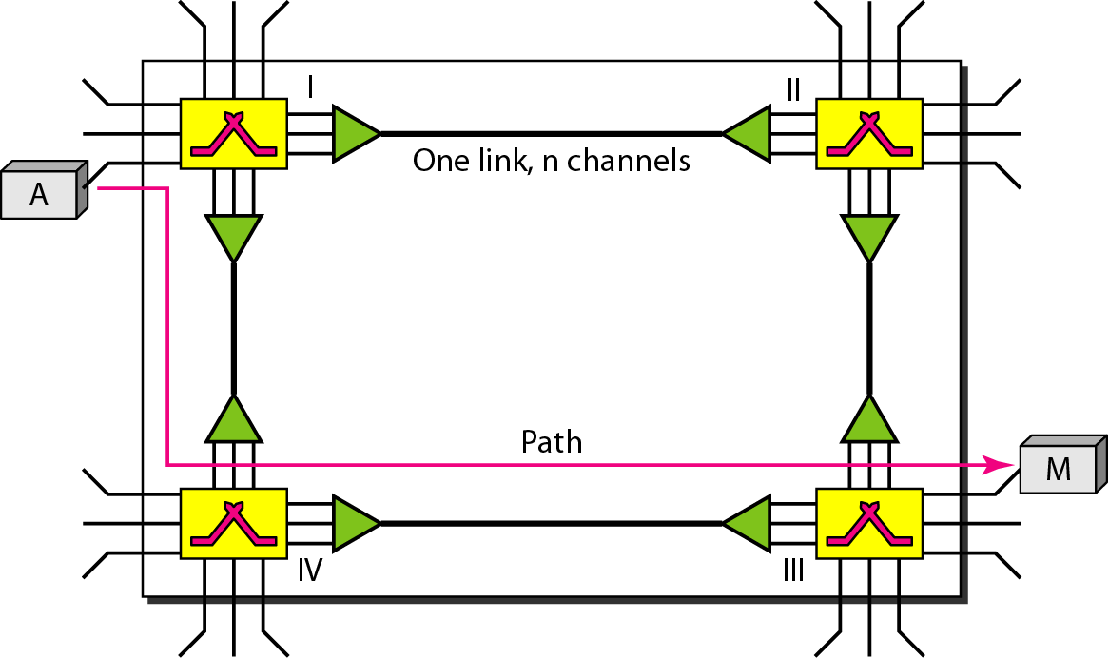
Circuit-Switched Networks (Cont.)

Slide 26
Circuit-Switched Networks (Cont.)
General Properties of Circuit Switching:
Takes place at the physical layer.
Resources need to be reserved during the setup phase.
Resources remain dedicated for the entire duration of data transfer and until the teardown phase.
Inefficient due to resources being allocated during the entire duration of connection, and these resources are unavailable to other connections.
Delay is minimal, where no delay is exerted over the switches at time of data transfer since all resources are allocated during the entire connection, hence no waiting time at the switches.

Slide 27
Circuit-Switched Networks (Cont.)
Example: As a trivial example, let us use a circuit-switched network to connect eight telephones in a small area. Communication is through 4-kHz voice channels. We assume that each link uses FDM to connect a maximum of two voice channels, hence bandwidth of each link is then 8 kHz.
Telephone 1 is connected to telephone 7; 2 to 5; 3 to 8; and 4 to 6. Of course the situation may change when new connections are made. The switch controls the connections.

Slide 28
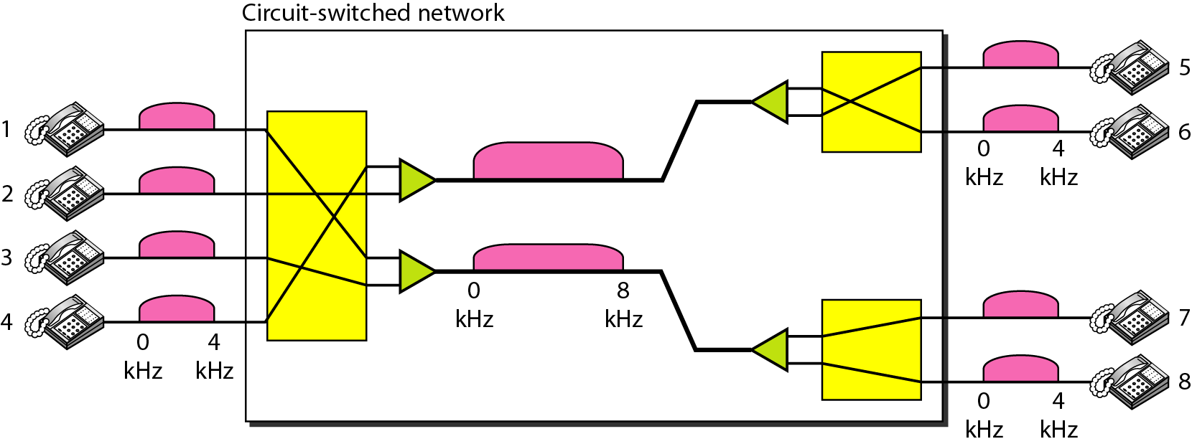
Circuit-Switched Networks (Cont.)

Slide 29
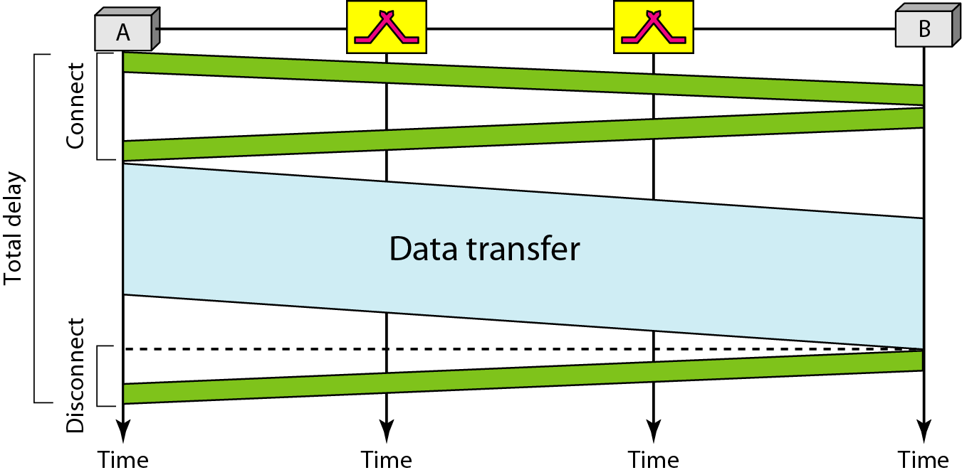
Circuit-Switched Networks (Cont.)

Slide 30
Packet Switching
Packet switched network: a network in which no resource allocation is required, hence no reserved channel on the link.
Resource are allocated on demand, where allocation is done on first-come, first-served basis. However, lack of reservation can create delay.
For a message to pass through a packet-switched network, it needs to be divided into packets of fixed or variable size.
Types of packet switching network:
Datagram networks
Virtual-circuit networks

Slide 31
Datagram Networks
General Properties of Packet Switching:
Each packet is treated independently.
Datagram switching is done at the network layer.
Switches in datagram network are referred to as routers.
May result in packets arriving out of order with different delays.
Packets can also be lost or dropped.

Slide 32
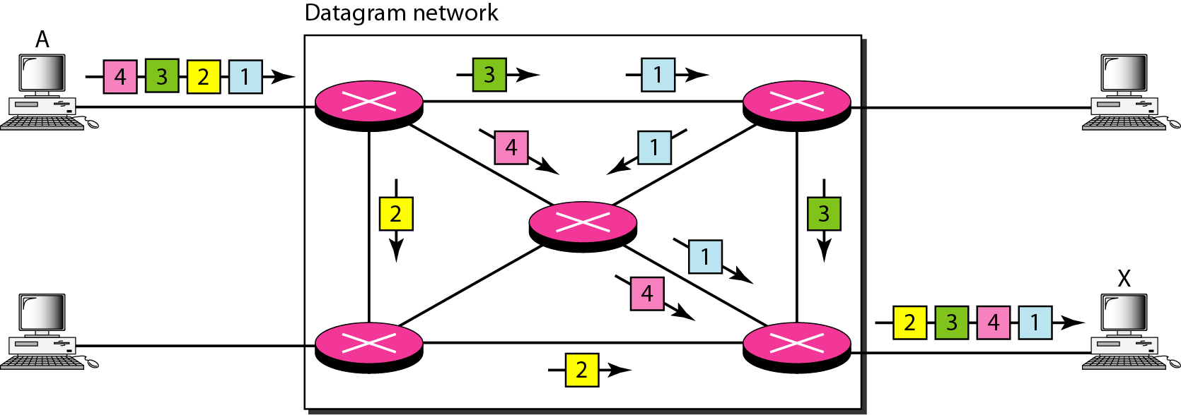
Datagram Networks (Cont.)

Slide 33
Datagram Networks (Cont.)
Datagram networks are sometimes referred to as connectionless networks, which means:
The router does not keep information on connection state.
No connection setup or teardown phases.
Each packet is treated as the same by the router regardless of its source or destination.

Slide 34
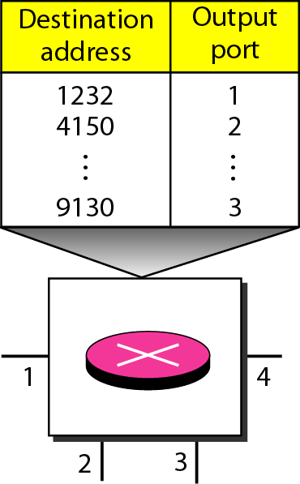
Datagram Networks (Cont.)
Routing Table Properties:
Each router has a routing table which is mainly based on the destination address.
Routing tables are created before arrival of packets, are dynamic and are updated periodically.
The designation address and the corresponding forwarding output ports are recorded in the tables.

Slide 35
Datagram Networks (Cont.)
Efficiency:
Efficiency of datagram network is better than circuit-switched network.
Resources are allocated only when there are packets to send.
Delay:
Greater delay might be experienced in datagram networks compared to circuit-switched network.
Each packet may experience a wait at the router before forwarding it.

Slide 36
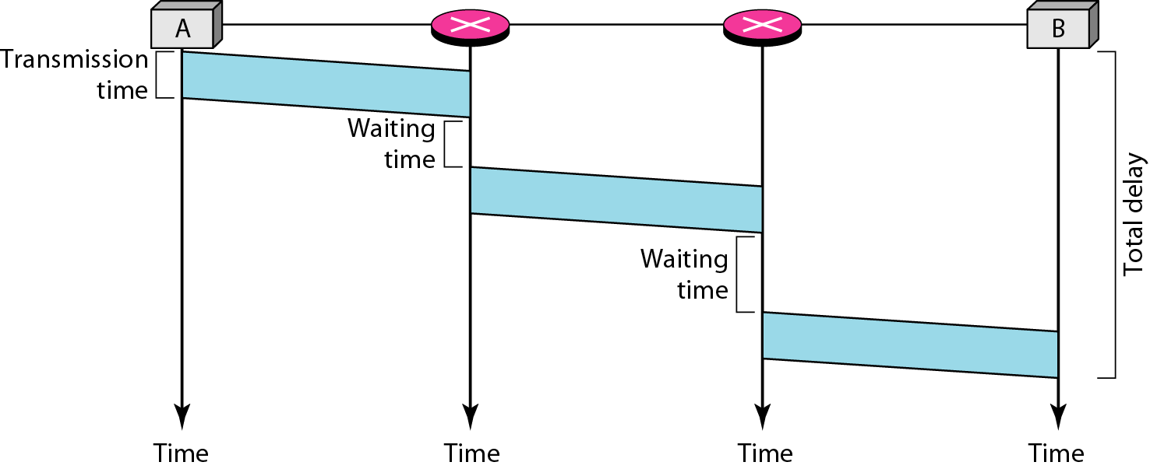
Datagram Networks (Cont.)

Slide 37
Thank You!

